Slide 1
CRIME RATE PREDICTION USING MACHINE LEARNING

Slide 2
About the application
Crime Rate Predictor is website that uses some AI (artificial intelligence) techniques to predict crime rates in 19 Indian metropolitan cities, with 10 types of crime from the year 2014 to 2024.
The goal of this project is to assist law enforcement agencies in understanding crime patterns and allocating resources effectively to reduce crime rates and improve public safety.

Slide 3
Member and guide introduction
The project team consists of talented individuals with expertise in various fields, including data science, machine learning, and software development. Their combined skills and dedication are essential for the successful development and deployment of the application.
Project Guide
The project is guided by Ms. Harshil Sharma a seasoned professional with extensive experience in the field of Artificial Intelligence and Data Analytics. Their Guidence and mentorship have been instrumental in shaping the project’s scope and ensuring it’s quality.
Madhav Lakhotia

Slide 4
Importance of Crime Rate Prediction
Prevention is better than cure. Preventing a crime from occurring is far better than investigating what happened. Just like vaccination protects a child from diseases, in today's world with rising crime rates, we need proactive systems to prevent crimes before they occur.
So, for this we had made a data fetching system which help peoples that give before knowledge to the user about the crime like which type of crime is recently at the peak and which at the bottom of the list.

Slide 5
1
Resource Allocation
Predictive analytics helps law enforcement agencies allocate resources, including personnel, equipment, and funding, to areas most likely to experience high crime rates. This ensures that limited resources are utilized effectively, enhancing overall efficiency and effectiveness.
2
Targeted Prevention
Predictive models can identify areas at risk of increased crime, enabling authorities to implement targeted prevention strategies. This includes proactive measures such as community outreach programs, increased patrols, and crime prevention workshops.
3
Public Awareness
The insights derived from crime rate prediction can be used to educate the public about crime trends and potential risks in their communities. This empowers individuals to take precautions and contribute to crime prevention efforts.

Slide 6
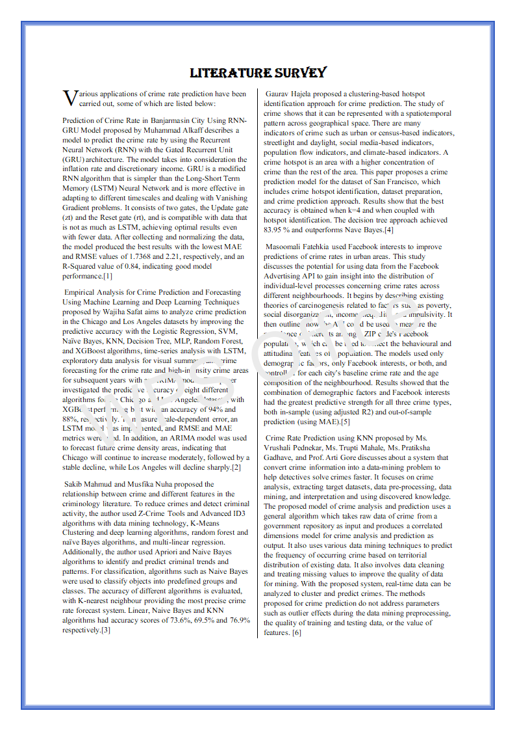
Enhancing your presentation

Slide 7
Problem Statement
It addresses the need for accurate and timely insights into crime patterns to enhance public safety and inform law enforcement strategies.
Definition of Crime Rate Prediction
Predicting the likelihood of future crimes based on historical data and external factors.
Importance of Accurate Crime Rate Prediction
Effective resource allocation, targeted crime prevention, and improved public safety.
Challenges in Crime Rate Prediction
Data availability, data quality, complex crime patterns, and the influence of socio-economic factors.
Objective
Develop a machine learning-based system to predict crime rates in India, considering various crime categories and geographical locations.

Slide 8




User Interface Features
City Selection
Select the desired city from a dropdown list.
Year Selection
Choose the year for which you want to predict the crime rate.
Crime Type Selection
Select the type of crime you want to predict.
Prediction
Click on the "Predict" button to generate the crime rate prediction.

Slide 9
Methodology
The methodology employed in this project involves a systematic approach to data collection, preprocessing, model development, and evaluation.
Data Collection
The project relies on various data sources, including official police records, crime statistics provided by the National Crime Records Bureau (NCRB), and publicly available data sets related to socio-economic factors. This data encompasses various crime categories, such as violent crimes, property crimes, and cybercrimes. These data sources are carefully selected and validated to ensure their accuracy and reliability.
Model Development
Various machine learning algorithms are explored and evaluated for their suitability in predicting crime rates. These include supervised learning techniques, such as Random Forest, Support Vector Machines (SVM), and Artificial Neural Networks. The choice of algorithm depends on the characteristics of the data, the desired level of accuracy, and the interpretability of the model.
2
4
1
3
Data Preprocessing
The collected data is preprocessed to ensure its suitability for machine learning algorithms. This involves cleaning the data by handling missing values, removing duplicates, and addressing inconsistencies. Data transformation techniques are applied to normalize the data, and feature engineering is employed to create new features that enhance the model's predictive power.
Model Evaluation
The performance of the trained models is rigorously evaluated using appropriate metrics, including accuracy, precision, recall, and F1-score. Cross-validation techniques are employed to ensure that the model's performance generalizes well to unseen data. The evaluation process helps in selecting the best performing model for deployment.

Slide 10
The Dataset
The dataset utilized for this project is sourced from the National Crime Records Bureau (NCRB) of India, providing a comprehensive overview of crime statistics from 2014 to 2024. The dataset encompasses detailed information on various crime categories, including murder, rape, theft, and assault.
Data Availability
The dataset is prepared manually based on publications available on the National Crime Rate Bureau (NCRB) official website.
Scope
The data provides statistics on the number of crimes committed in 19 Indian metropolitan cities during the year 2014 to 2024.
Crime Categories
It includes statistics on 10 different categories of crime, including murder, kidnapping, crime against women, crime against children, crime committed by juveniles, crime against senior citizens, crime against SC, crime against ST, economic offenses, and cyber. crimes.

Slide 11
Tools and Technologies Used
The development of this crime prediction system utilizes a combination of powerful tools and technologies. We leverage Python, a versatile programming language renowned for its data analysis capabilities, along with popular libraries such as Pandas for data manipulation, Scikit-learn for machine learning algorithms and Databases.
1
2
Front-end
HTML and CSS are used for the user interface, allowing users to interact with the system through web pages for adding city, year & type of crime.
Back-end
Python, versatile programming language for data analysis and machine learning.
3
4
Database
MySQL database is used to securely store and manage all the related data.
Libraries
Pandas, Scikit-learn a machine learning library for data manipulation, analysis and algorithms.

Slide 12
Algorithm
The algorithm underpinning this crime prediction system utilizes a supervised learning approach. We train a machine learning model on historical crime data, which includes factors such as location, time of day, type of crime, and demographic information. The model learns patterns and correlations within the data, allowing it to predict the likelihood of specific crimes occurring in the future. This approach allows for proactive crime prevention by identifying areas at higher risk and deploying resources accordingly.
1
Data Collection
Gathering historical crime data from various sources, including police records, news reports, and open data platforms.
2
Data Preprocessing
Cleaning, transforming, and preparing the data for model training, addressing missing values and inconsistencies.
3
Feature Engineering
Creating new features from existing data, such as combining multiple variables or calculating derived values, to improve model accuracy.
4
Model Training
Training the chosen machine learning model on the processed data, allowing it to learn patterns and relationships.
5
Model Evaluation
Evaluating the performance of the trained model using various metrics, such as accuracy, precision, and recall, to ensure its effectiveness.

Slide 13
Feature Engineering and Selection
Feature engineering is a critical aspect of building an effective crime prediction model. We carefully select and engineer features that are most relevant to predicting crime, taking into account factors such as socioeconomic indicators, environmental factors, and historical crime patterns. This involves analyzing data, identifying key variables, and transforming them into features that can be effectively used by the machine learning model. This process aims to maximize the model's ability to learn and predict crime trends accurately.
Feature
Description
Location
Geographical coordinates of the crime incident, including latitude and longitude.
Time of Day
Hour of the day when the crime occurred, allowing for analysis of temporal patterns.
Day of Week
Day of the week when the crime occurred, potentially revealing weekly patterns.
Type of Crime
Category of crime, such as theft, assault, or vandalism.
Population Density
Number of people per unit area, which can influence crime rates.
Unemployment Rate
Percentage of unemployed individuals in the area, potentially linked to economic distress and crime.
Income Level
Average income of residents in the area, potentially reflecting socioeconomic factors contributing to crime.

Slide 14
Conclusion and Future Work
Crime Reduction
Data Analysis and Visualization
Community Safety
Crime rate prediction is an important tool for law enforcement agencies to help them focus their resources in high-crime areas.
Machine learning helps find relationships and patterns between various data, enabling easier data analysis and visualization.
The model's prediction of crime rates and data visualization help in understanding different crime datasets, which can be used in implementing factors that contribute to a safer society.

Slide 15
Thank you
We appreciate your time and consideration. We believe this crime prediction system holds significant potential to improve public safety in India. We are committed to developing a robust and effective system that empowers law enforcement agencies with valuable insights and tools for proactive crime prevention.

